Slide 1
Design a menu & ordering app for a cafe
17.1.2024
Team
Jana Nozickova

Slide 2
Table of Contents
Section 1 Study Details
Section 2 Themes
Section 3 Insights & Recommendations

Slide 3
Study Details

Slide 4
Project Background
We’re creating a new app for a Café, where users place orders in advance. We need to find out if the main user experience, searching and ordering from the menu is easy for users to complete. We’d also like to understand the specific challenges that users might face in the searching ordering processes.

Slide 5
Study Details
Research Questions
Participants
Methodology
How long does it take a user to go through the order in the app?
What are the steps that users take to order their coffee?
Are there parts of the user flow where users get stuck?
Are there more features that users would like to see included in the app?
Do users think the app is easy or difficult to use?
Participants are all people who visits a cafe at least once a week
Two males, two females, and one nonbinary individual, aged 18 to 60. One participant is a person with a visual impairment.
The study is accessible for use with a screen reader and a switch device.
Unmoderated usability study
Location: Brno,, remote (each participant will complete the study
in their own home)
Date: Sessions will take place on February 1 (weekday, normal business hours) and February 2 (weekend day)
Length: Each session will last 10-20 minutes, based on a list of prompts

Slide 6
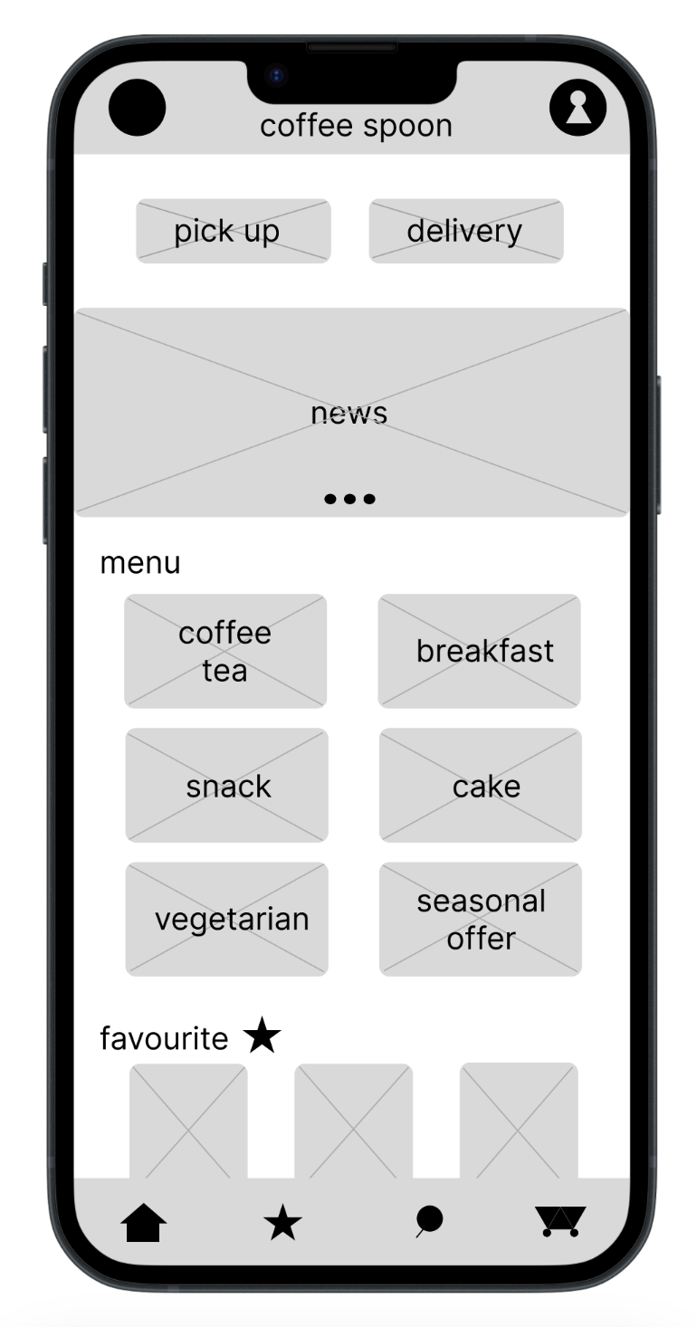

Prototype / Design Tested
Screenshot of homepage

Slide 7
Themes

Slide 8
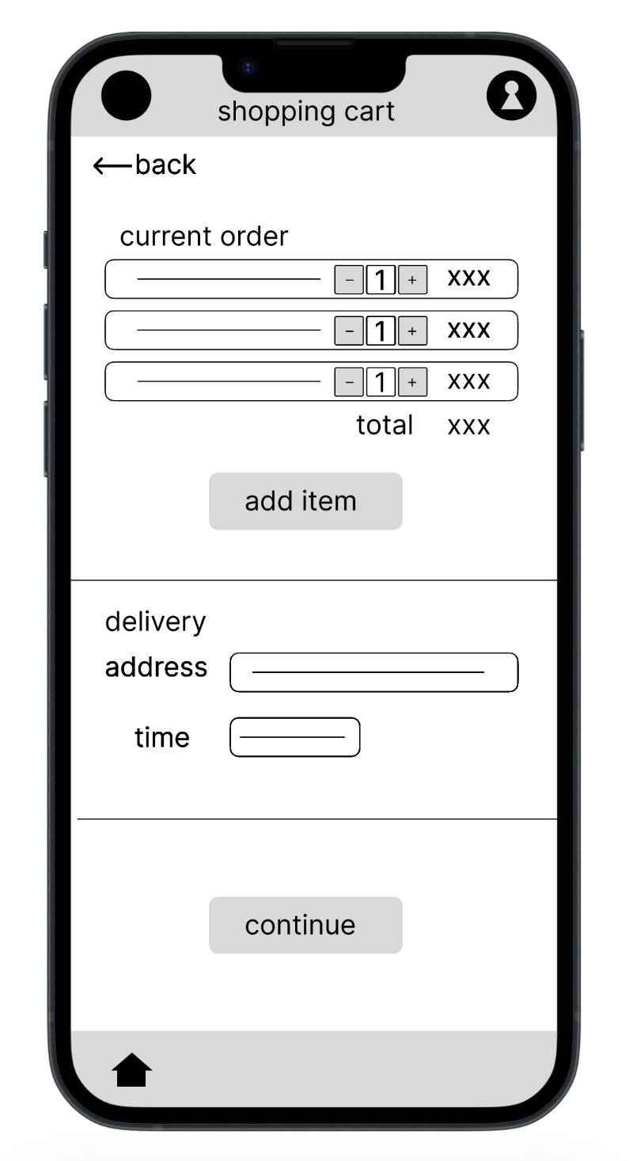
Theme #1
For most users it is important to check their order twice before ordering
4 out of 5 participants had trouble with the checkout process when there was no final summary before order.
"I expected brief summary of my order in addition, but straight away congrants screen appeared."

Slide 9
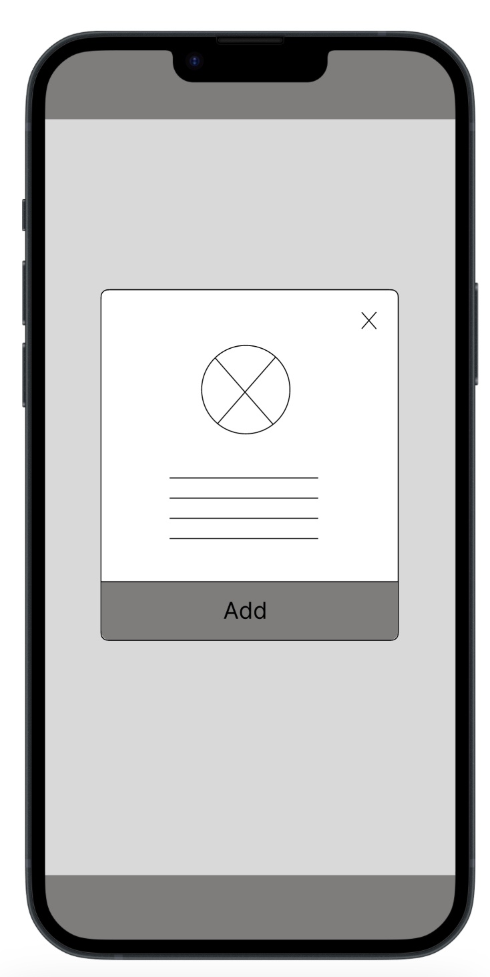
Theme #2
Not everyone needs to display details of the item to order it.
3 out of 5 participants found difficulty in searching the menu, because it is possible to order the item only from the item detail
"Now, I do not know, what to do. I am confused. When I press the image, nothing happened. I got stuck."
a

Slide 10
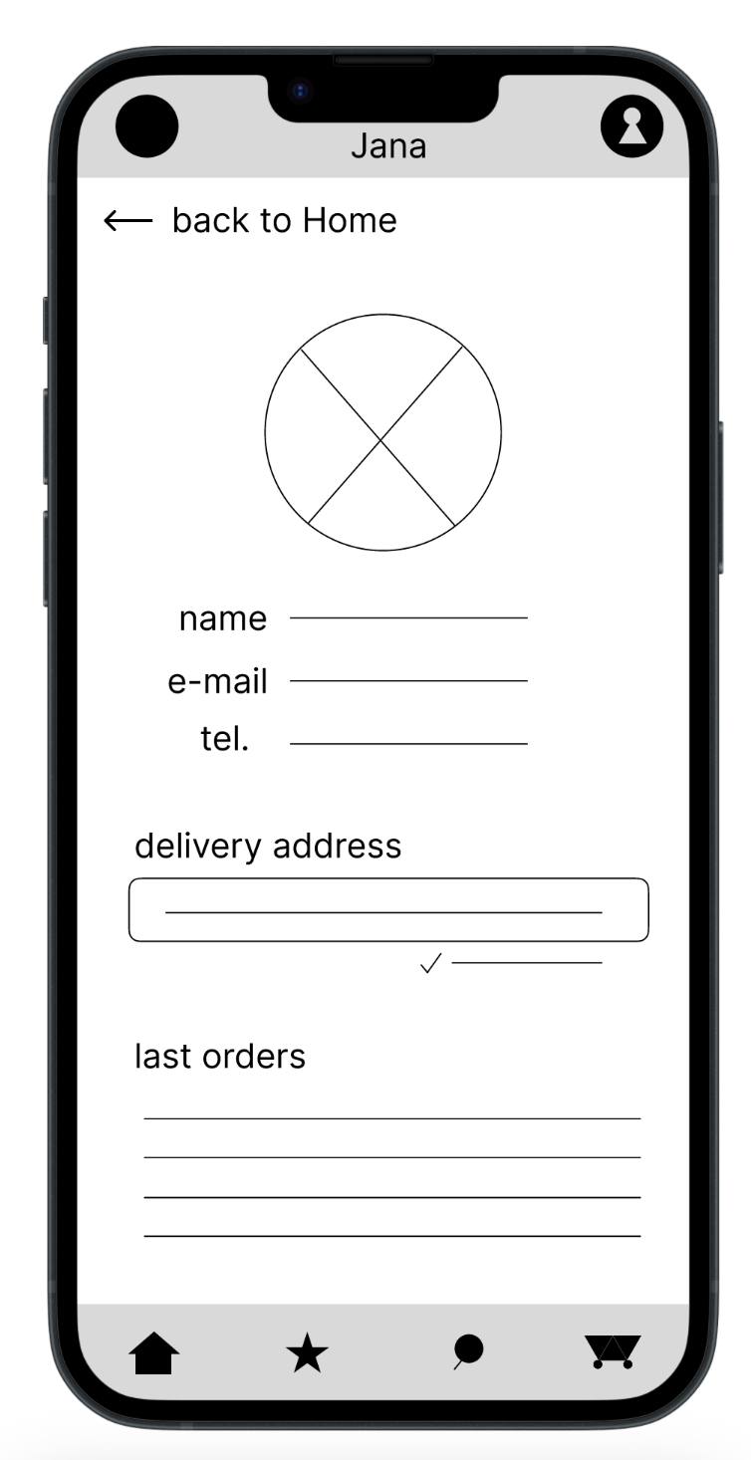
Theme #3
A few people do not need to have save details about them, but most people found it useful.
2 out of 5 participants were wondering why they need a profile created
"I think I give up, I do not need to create profile to order the coffee, I guess. Sorry."
a

Slide 11
Theme #4
A small sample of people finds difficulties when adding an address, but not for the majority.
2 out of 5 participants would appreciate a map or some help when adding an address
"I would appreciate opening some map, when I filling in the address."
a

Slide 12
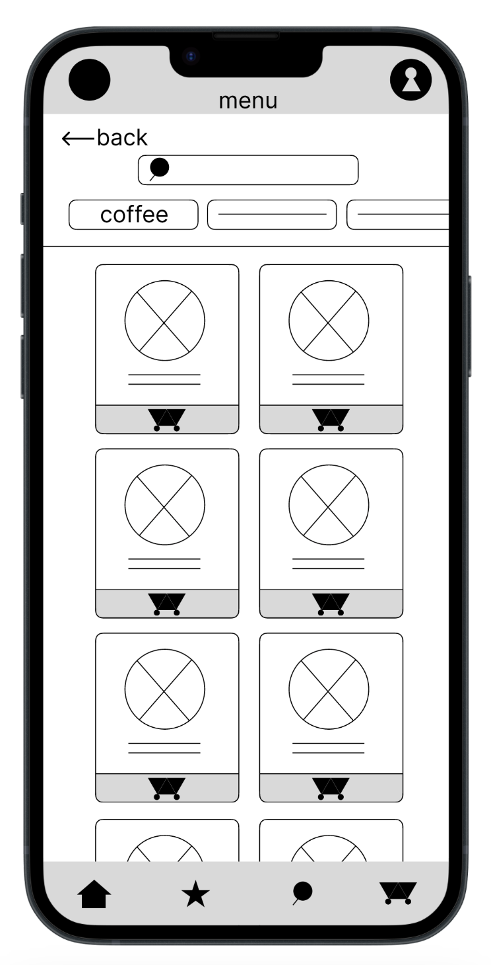
Theme #5
For most people it is important to order coffee as easily and intuitively as possible.
4 out of 5 participants found the checkout process quick and smooth
"Yes, this is an easy App. I like it."
a

Slide 13
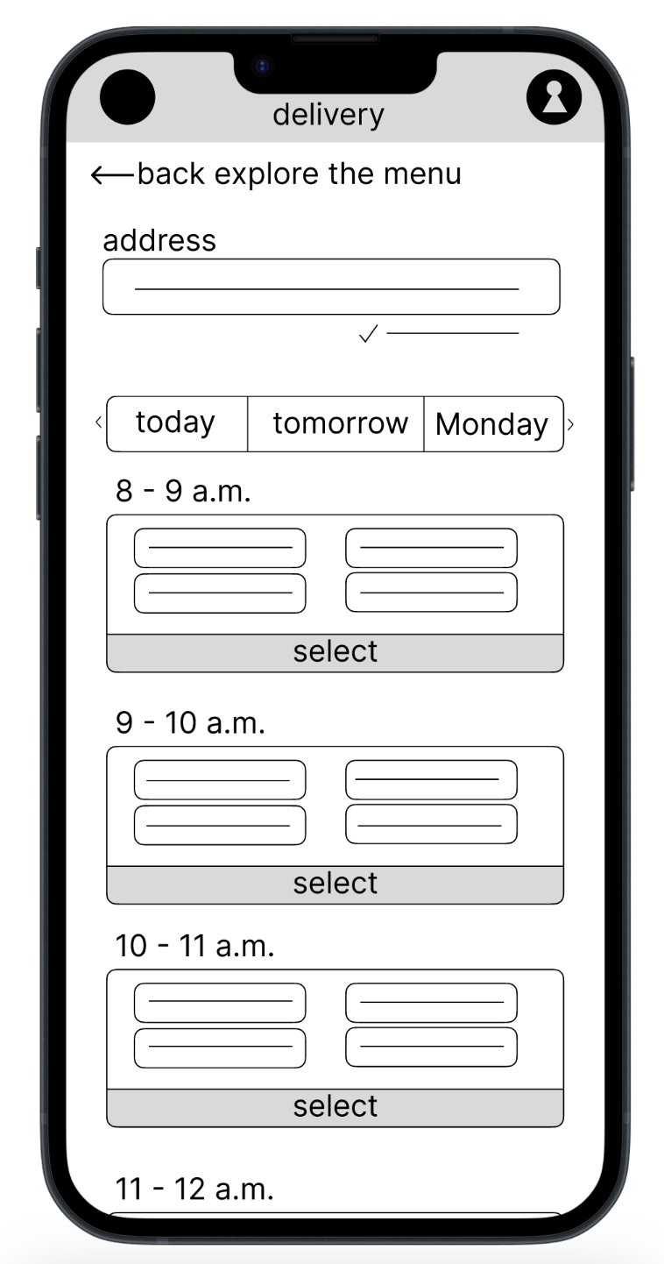
Theme #6
For most users delivery and time searching are intuitive and clear.
3 out of 5 participants appreciated the intuitive schedule of delivery and time
"I like this time schedule, very intuitive."
a

Slide 14
Insights & Recommendations

Slide 15
Research insights
no final summary before order
it is possible to order the item only from the item detail
Appreciate a map or some help when adding an address
Users like saved information in their profile
Users need to be assured about their order more, adding final summarization.
Some users would appreciate more features in the app
Users need smoother user flow when getting the information about the product and ordering it.
Users like to have personal information saved, so they do not need to fill it again and again.

Slide 16
Recommendations
Add new screen with summarization of the order
Make additional connections dealing with the menu and detail of the items
Make user flow clear, so that users who does not want to create profile can order as well, with no profile needed.

Slide 17
Thank you!

